Slide 1
“Navigating AI Governance and Security: Global Perspectives.”
A proposed report structure
February 28, 2025

Slide 2

The report’s objectives
Synthesis Amid rapid change and a flurry of AI-related research, we pinpoint the most important dynamics likely to impact the Collaborative’s membership.
Thought leadership Help establish the Collaborative as a key convening forum and resource around emerging AI governance and geopolitical challenges.
Basis for discussion Help inform themes and topics to be covered during the DC Summit and online salons.

Slide 3
Proposed report structure
Part I: An AI Retrospective
Part II: Regional snapshots
Overview of the key governance and geopolitical developments in the AI sphere in the preceding year.
An overview of how current and emerging trends may drive AI development and deployment moving forward.
Insights into how Collaborative members can prepare for these developments and reduce their operational risk.
Deep dives into developments most likely to impact Collaborative members’ operational environment across six key regions:
  United States
  Europe (including UK)
  China
  Asia-Pacific: emphasis on South-Korea, Japan, India, Taiwan
  Middle-East

Slide 4
Surfacing interconnections
Intersecting trends: our primary focus is on surfacing key developments in the geopolitical, security and governance realm. The report however also explores how technological developments and market dynamics drive and further reinforce these dynamics.
E.g. a slowdown in consumer-focused growth and investment may drive development of national security applications of AI.
Concentric circles: AI does not develop in a vacuum. We will thus also look at how developments in the broader innovation sphere, and global trends more generally, can shape the Artificial Intelligence domain.
E.g. semiconductor export controls and broader geopolitical fragmentation may lead to diverging AI development pathways in different geographies (the US, China and EU).
AI domain
Global trends
and drivers
Technology & innovation trends

Slide 5

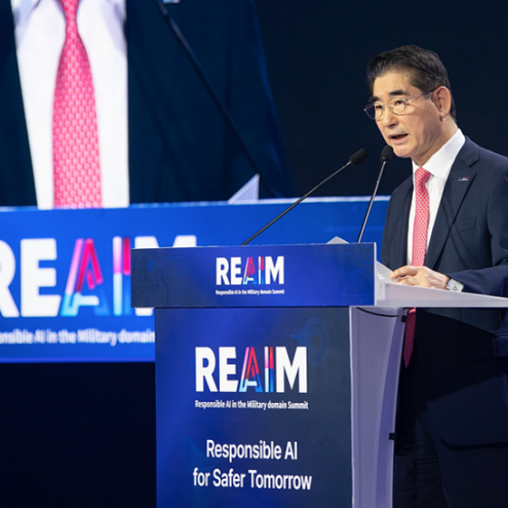
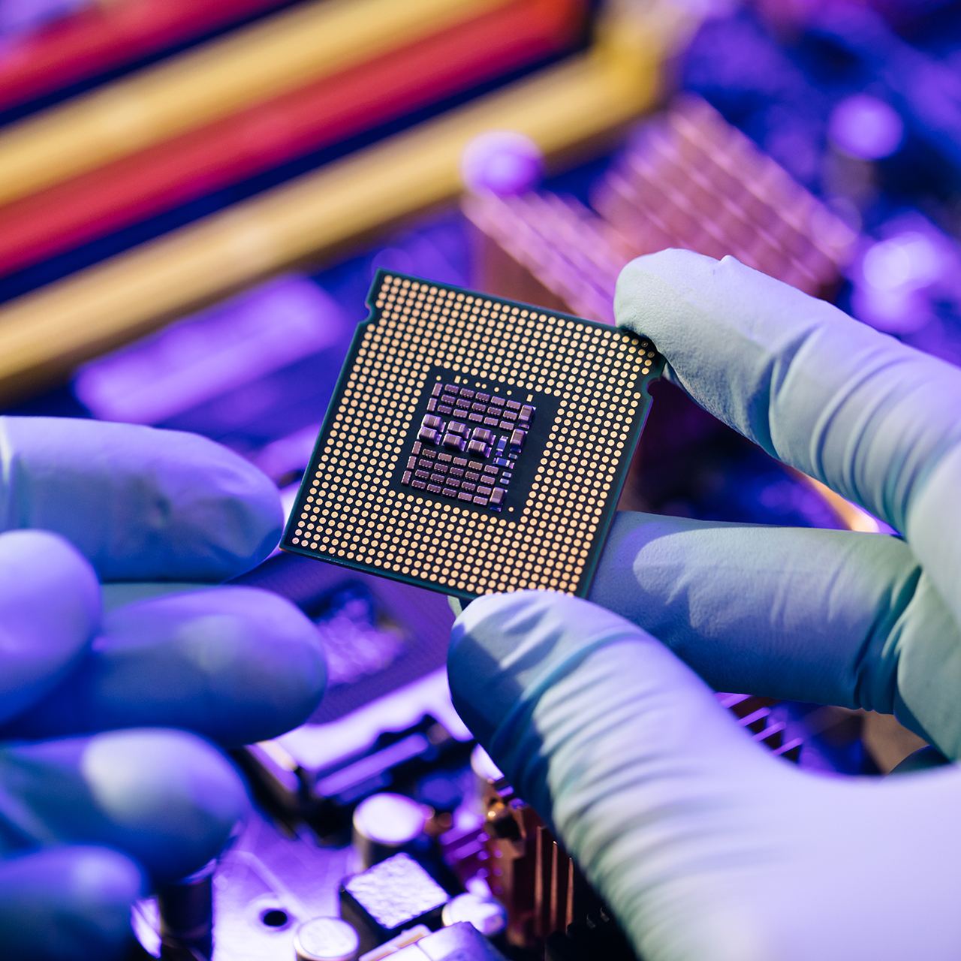
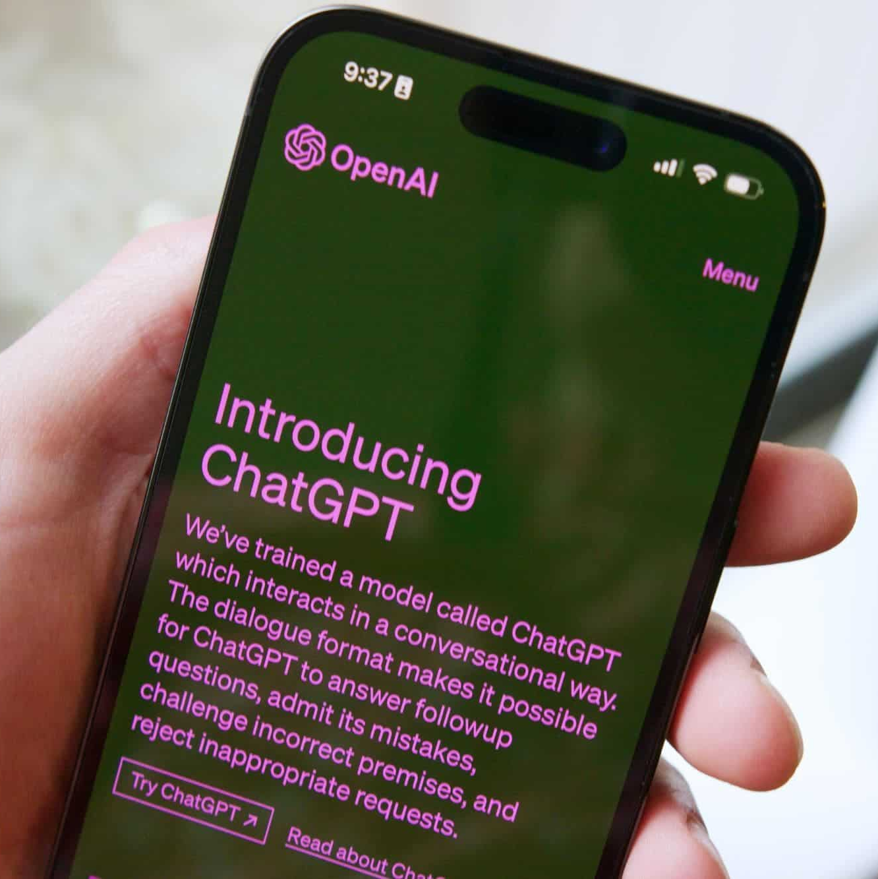
Explore dynamics across four dimensions
Geopolitics and international security
Regulation and global governance
Technological progress
Market drivers
How are geostrategic considerations shaping the AI landscape? And what role does AI play in driving geopolitical tensions?
How are developments in the regulatory and global governance sphere impacting AI R&D and deployment?
Will AI and its underpinning hardware and infrastructures continue to improve, or could we see the pace of innovation begin to slow down?
How are dynamics intrinsic to AI and AI-enabling markets shaping the technology’s future trajectory?

Slide 6
Explore dynamics across four dimensions
Geopolitics and international security
Regulation and global governance
Technological progress
Market drivers
E.g.
- Sino-American competition
- An increase in AI-enabled hybrid and cyberattacks
- the growing military use and securitisation of AI
E.g.
- US new positions on domestic and international regulation
- Impact of governance initiatives such as the Paris Action Sumit
- The global push for data localisation and sovereignty
E.g.
- The growing environmental impact of AI
- Slowdown in improvements in the accuracy and power of LLMs
- Advances in other emerging technologies such as quantum
E.g.
- Concerns about a slowdown (or possible crash) in AI investment + rise of Open Source
- Rapid growth in demand for AI data centres and compute

Slide 7
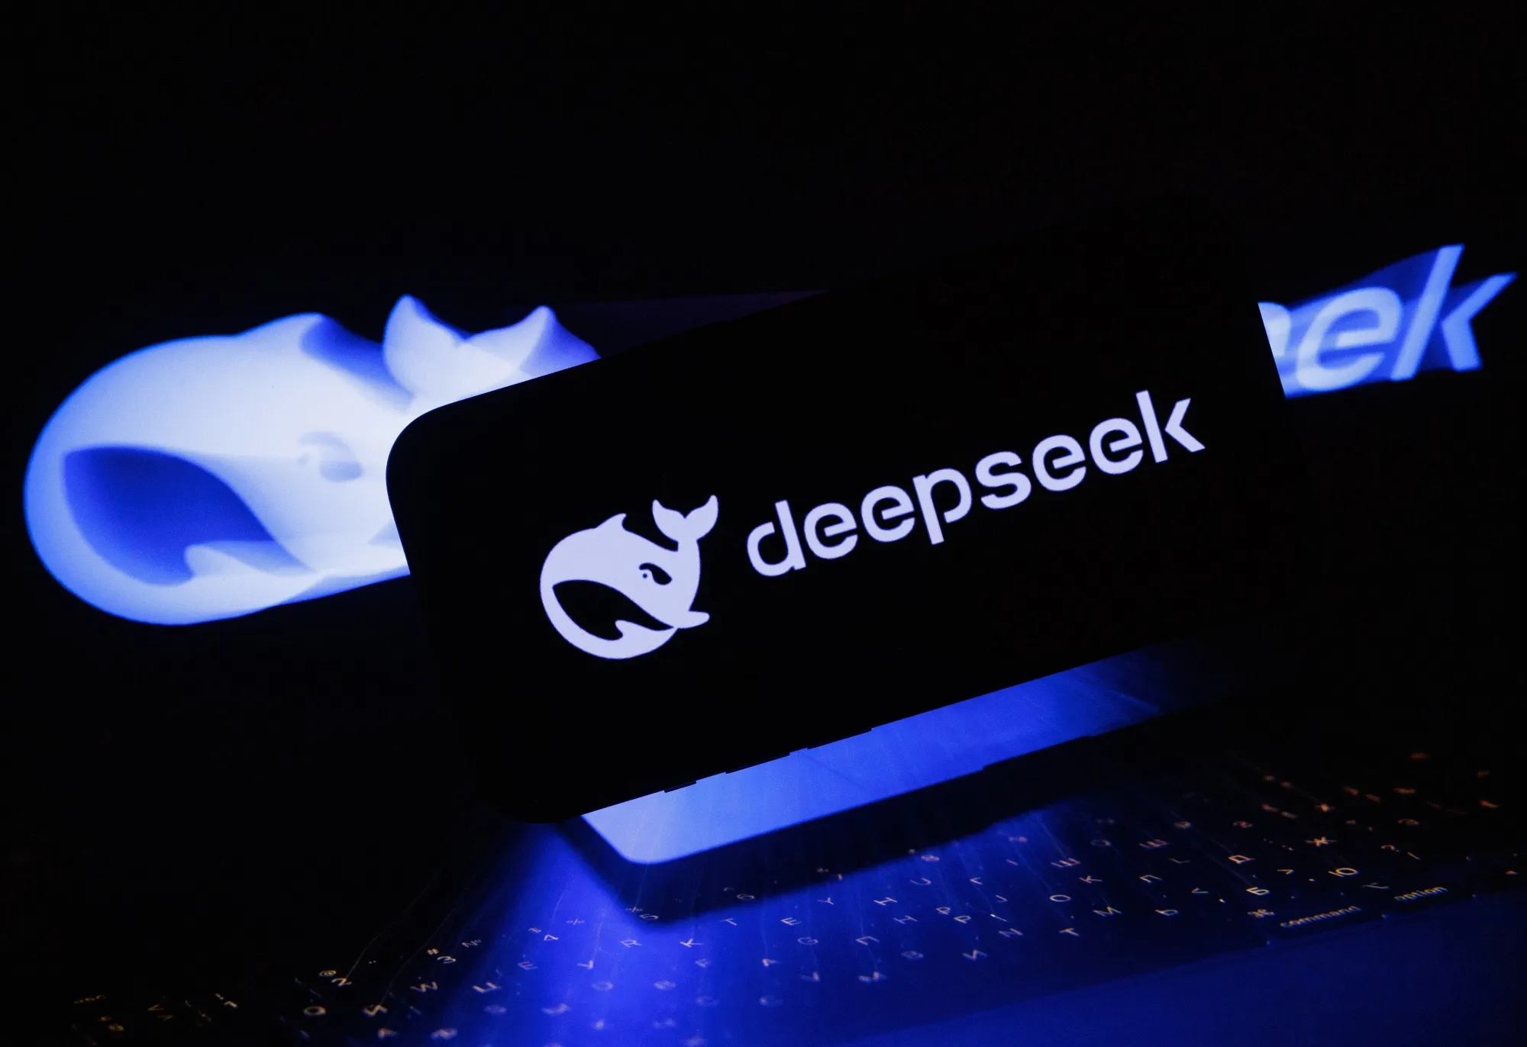
Regional snapshots
The main body of the report will zoom in on developments in key regions (Six chapters: US, Europe, China, Asia-Pacific, Middle-East)
Overview of key AI governance and security-related developments (in 2025) in each region.
Case studies into specific trends of particular interest to collaborative members.
    E.g. (DeepSeek in China; Eurostack and the AI Act in Europe; Stargate Project + new Trump Admin export controls; UN AI Governance processes; UK’s AI Opportunities plan)
Outlook: what do we expect for 2026 and beyond? Where do we see risks and opportunities?

